Slide 1



2024 International Conference on Life Sciences
Guiyang, China
The 19th SCBA/14th CBIS Biennial Symposium Guide
July 25-30,2024
Welcome to Guiyang！
Organizing Committee
July 4th,2024

Slide 2
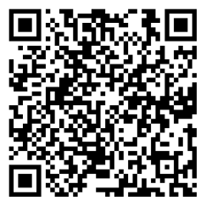
1、Basic information
Date
Venue
Symposium：CHINA-ASEAN INTERNATIONAL CONFERENCE CENTER
Agenda
Jul. 25 2:00-8:00pm Arrival and Registration
Jul.26-Jul.29 8:30am-6:00pm Symposium
Jul.30 Excursion and Departure
Jul.25-Jul.30
Registry：Howard Johnson Qunsheng Plaza Lobby (the 1st floor)
Poster：The 2nd floor of Conference center
Symposium Program

Slide 3
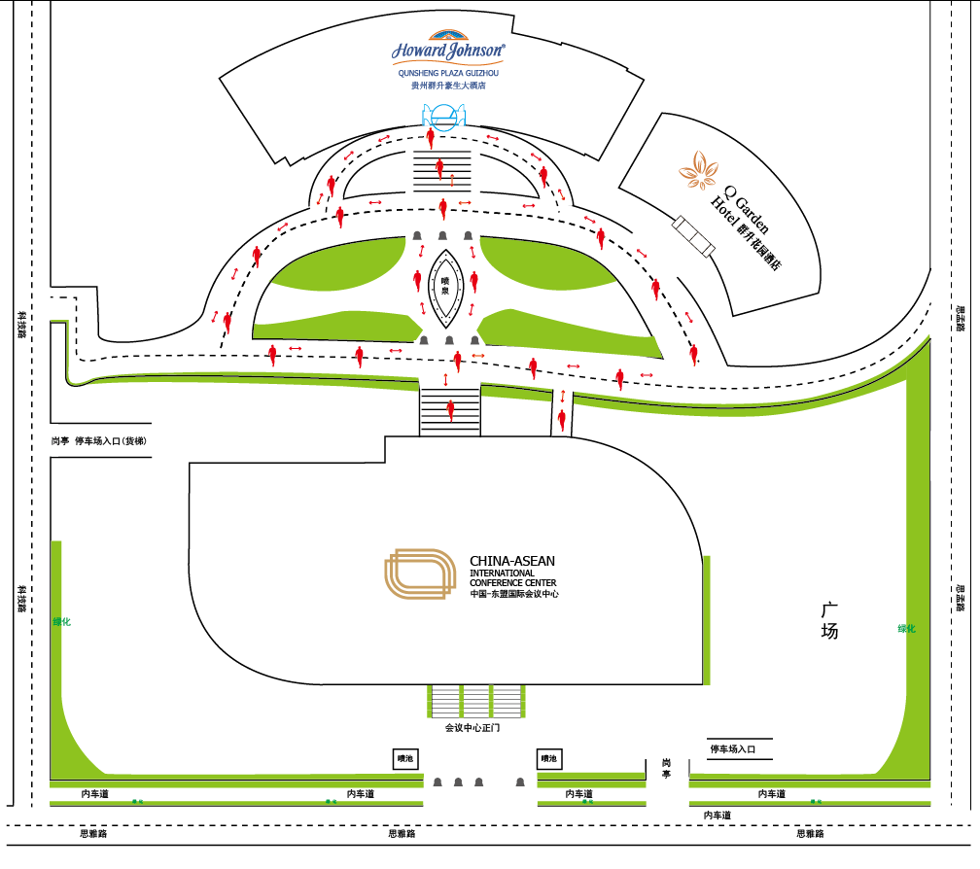
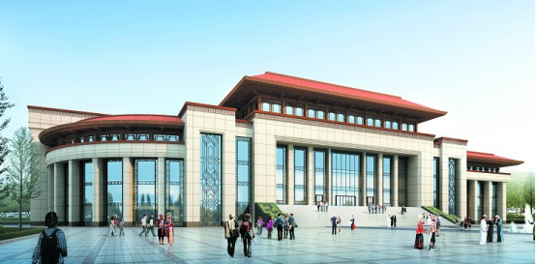
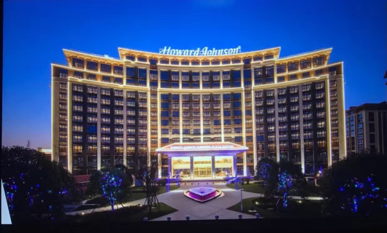
2、Locations
群升豪生酒店
Registry
Symposium Venue：CHINA-ASEAN INTERNATIONAL CONFERENCE CENTER
Registry Site：Howard Johnson Qunsheng Plaza Lobby (the 1st floor)
东盟会议中心
Symposium

Slide 4
3、Accommodation
Guizhou reservation channels：
Howard Johnson Qunsheng Plaza（Tel：0851-8891 9999 transfer to Reservation Department，fully booked）
Q-Garden Hotel Guizhou（Tel: 0851-8891 9999 transfer to Reservation Department， fully booked ）
Kyriad Guiyang Huaxi University Town（Tel: 0851-88902888 ， fully booked ）
Colorful Guizhou Hotel（Tel: 86-130 1745 5773, Mr. Guo ）
More information about hotels：https://www.csbmb.org.cn/2024SCBA&CBIS/accommodation.html

Slide 5
4、Transportation
Railway Station
Guiyang North Railway Station: about 40 kilometers，Taxi: around 70.00 RMB
Guiyang Railway Station: about 23 kilometers，Taxi: around 50.00 RMB
Guiyang Longdongbao International Airport
Distance: about 35 kilometers，Taxi: around 70.00 RMB
Shuttle Bus from: Guiyang North Railway Station (West exit）
Longdongbao International Airport
July 25：10:00am-11:00pm (One Bus every hour)
July 26：Departure at 10:00am、12:00am、3:00pm
Please pay attention to the sign by volunteer at the exit

Slide 6
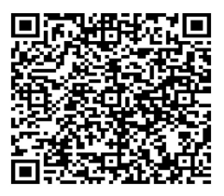
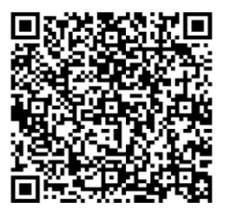
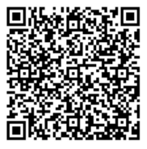

5、Excursion
One-day Tour to Huangguoshu Waterfall（Original price: 580.00/person；Favorable price：210.00 /person ）
One-day Tour to the Site of Zunyi Conference（ Original price: 380.00/person；Favorable price：190.00 /person ）
One-day Tour to China FAST（Original price: 490.00/person；Favorable price：245.00 /person ）
One-day Guiyang City（ Original price: 420.00/person；Favorable price：175.00 /person ）
Scan QR code to join:
Huangguoshu Waterfall Zunyi Conference China FAST Guiyang City
Note：The Favorable prices are only for July 30

Slide 7

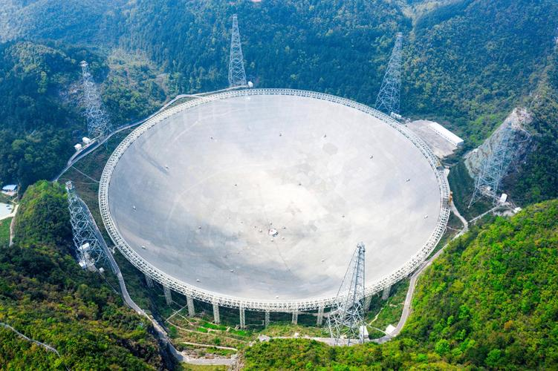
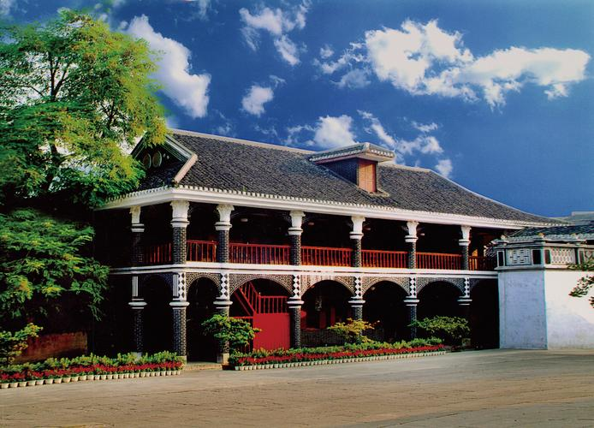

Wish you have a good time in Guiyang!
Welcome to Guiyang！

